Slide 1


CREDIT CARD FRAUD DETECTION

Slide 2
ABSTRACT
With the growing usage of credit card transactions, financial fraud crimes have also been drastically increased leading to the loss of huge amounts in the finance industry. Having an efficient fraud detection method has become a necessity for all banks in order to minimize such losses. In fact, credit card fraud detection system involves a major challenge: the credit card fraud data sets are highly imbalanced since the number of fraudulent transactions is much smaller than the legitimate ones. Thus, many of traditional classifiers often fail to detect minority class objects for these skewed data sets.
This Project deals with CREDIT CARD FRAUD DETECTION USING MACHINE LEARNING. Machine learning models can recognise unusual credit card transactions and fraud involving collecting and sorting raw data, which is then used to train the model to predict the probability of fraud.

Slide 3
INTRODUCTION
A credit card is a thin handy plastic card that contains identification information such as a signature or picture, and authorizes the person named on it to charge purchases or services to his account - charges for which he will be billed periodically. Today, the information on the card is read by automated teller machines (ATMs), store readers, and banks and is also used in online internet banking systems. They have a unique card number which is of utmost importance. Its security relies on the physical security of the plastic card as well as the privacy of the credit card number.
There is a rapid growth in the number of credit card transactions which has led to a substantial rise in fraudulent activities. Credit card fraud is a wide-ranging term for theft and fraud committed using a credit card as a fraudulent source of funds in a given transaction. Generally, statistical methods and many data mining algorithms are used to solve this fraud detection problem. Most of the credit card fraud detection systems are based on artificial intelligence, Meta learning and pattern matching. A proper and thorough literature survey concludes that there are various methods that can be used to detect credit card fraud detection.

Slide 4
MOTTO
The challenge is to recognize fraudulent credit card transactions so that the customers of credit card companies are not charged for items that they did not purchase.

Slide 5
METHODOLOGY

Slide 6
Unsupervised Learning - Machine Learning Algorithms such as Isolation Forest, One-class SVM, LOF, etc., do not require labelled data for training the model. They identify patterns in the data and try to group the data points based on observed similarities in patterns.
Supervised Learning - Machine Learning Algorithms such as Ensemble Models (RandomForest, XGBoost, LightGBM, etc.), KNN, Neural Networks, Autoencoders, etc. These algorithms are trained on labelled data, and the model learns to predict the labels for the unseen data. Labelled data can be expensive to gather.

Slide 7
Like humans, machine learning algorithms learn from past transaction data and use that information to analyse future transactions with the same lens. While machines might not be as intelligent as humans are and might need some supervision on top of it, the advantage lies in the speed of data processing and computation. Also, machines can identify and remember more patterns in vast volumes of data compared to humans. Generally, these algorithms are known as Anomaly Detection.
The benefits of using machine learning for credit card fraud detection:
Faster Detection
High Accuracy
Improved efficiency with larger data

Slide 8
MAIN CHALLENGES INVOLVED IN CREDIT CARD FRAUD DETECTION

Slide 9
Enormous Data is processed every day and the model build must be fast enough to respond to the scam in time.
Imbalanced Data i.e., most of the transactions (99.8%) are not fraudulent which makes it really hard for detecting the fraudulent ones
Data availability as the data is mostly private.
Misclassified Data can be another major issue, as not every fraudulent transaction is caught and reported.
Adaptive techniques used against the model by the scammers.

Slide 10
HOW TO TACKLE THESE CHALLENGES?

Slide 11
The model used must be simple and fast enough to detect the anomaly and classify it as a fraudulent transaction as quickly as possible.
Imbalance can be dealt with by properly using some methods which we will talk about in the next paragraph
For protecting the privacy of the user, the dimensionality of the data can be reduced.
A more trustworthy source must be taken which double-check the data, at least for training the model.
We can make the model simple and interpretable so that when the scammer adapts to it with just some tweaks, we can have a new model up and running to deploy.

Slide 12
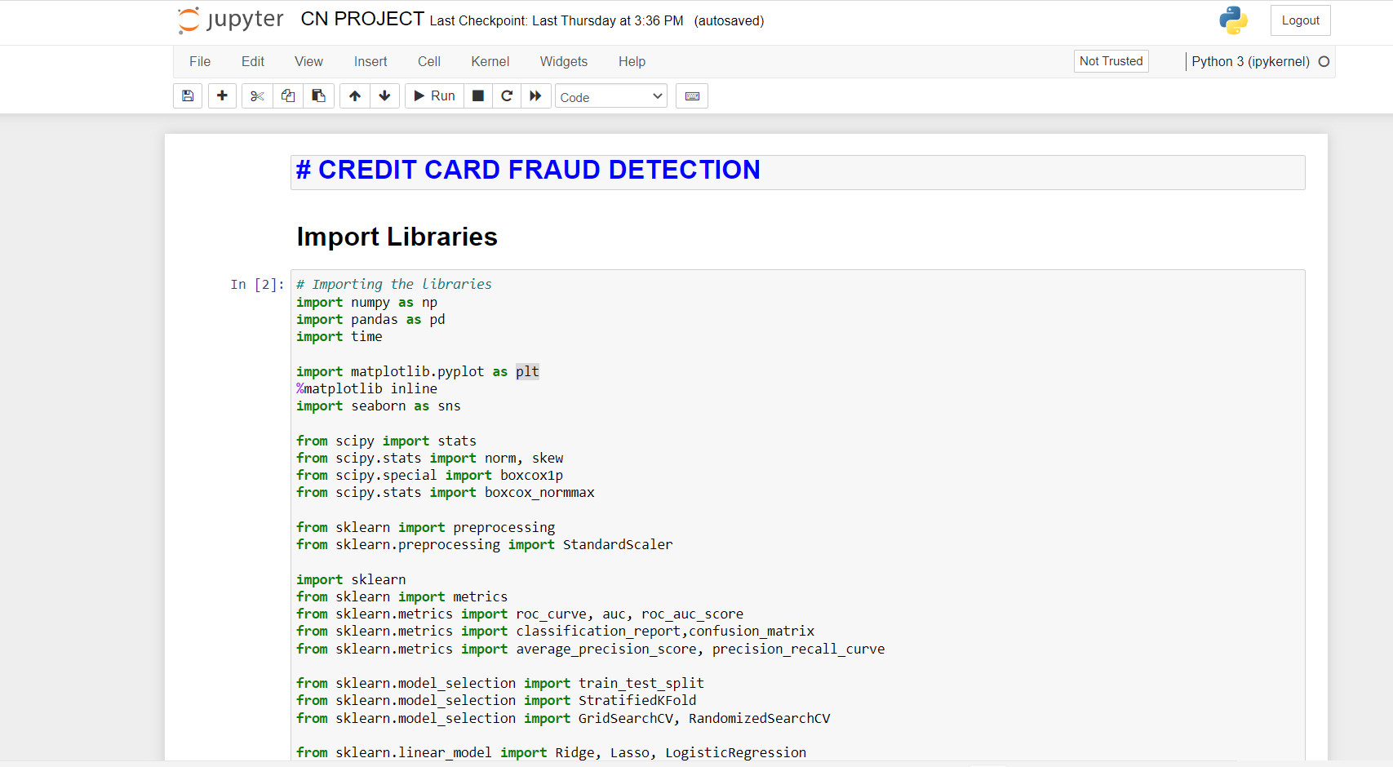

Slide 13
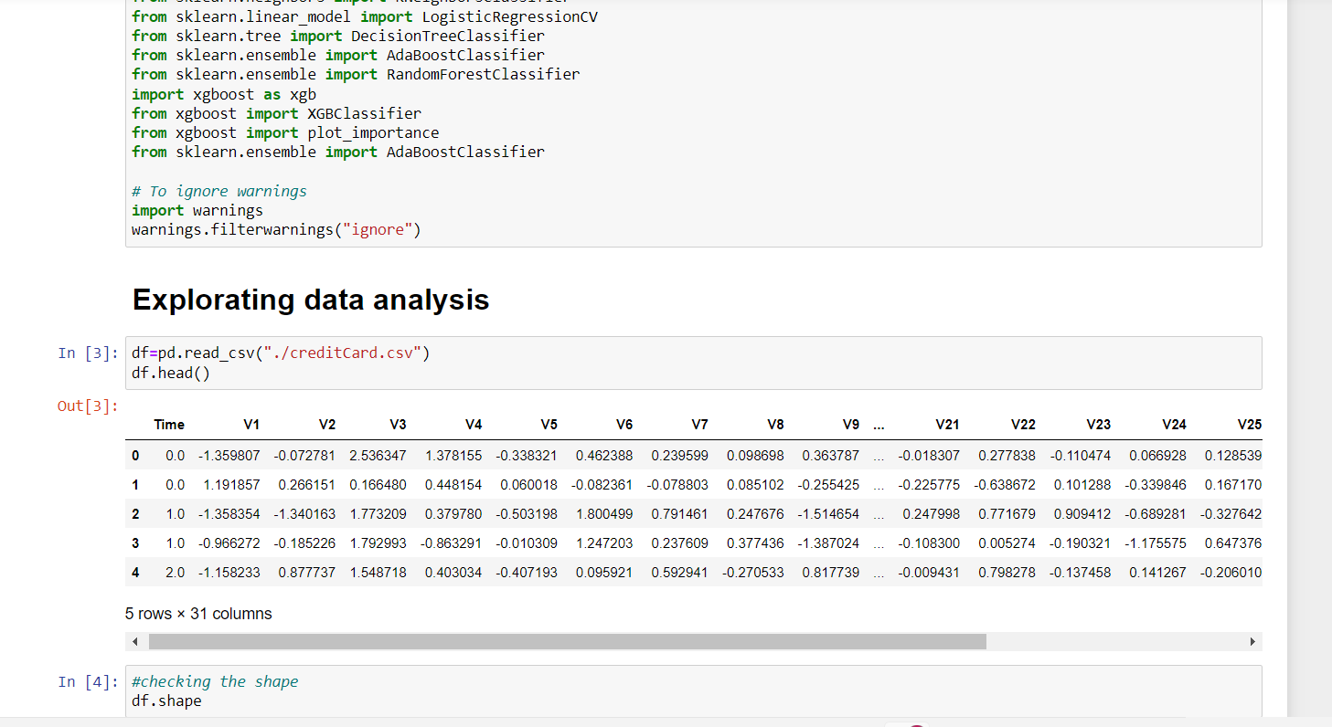

Slide 14
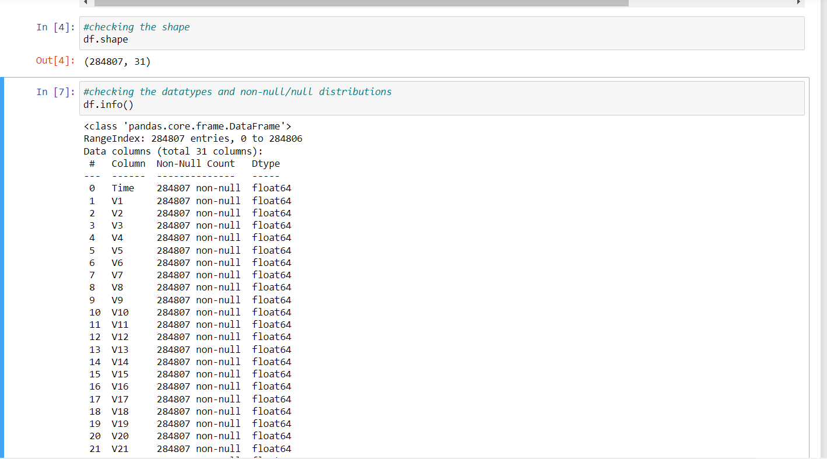

Slide 15
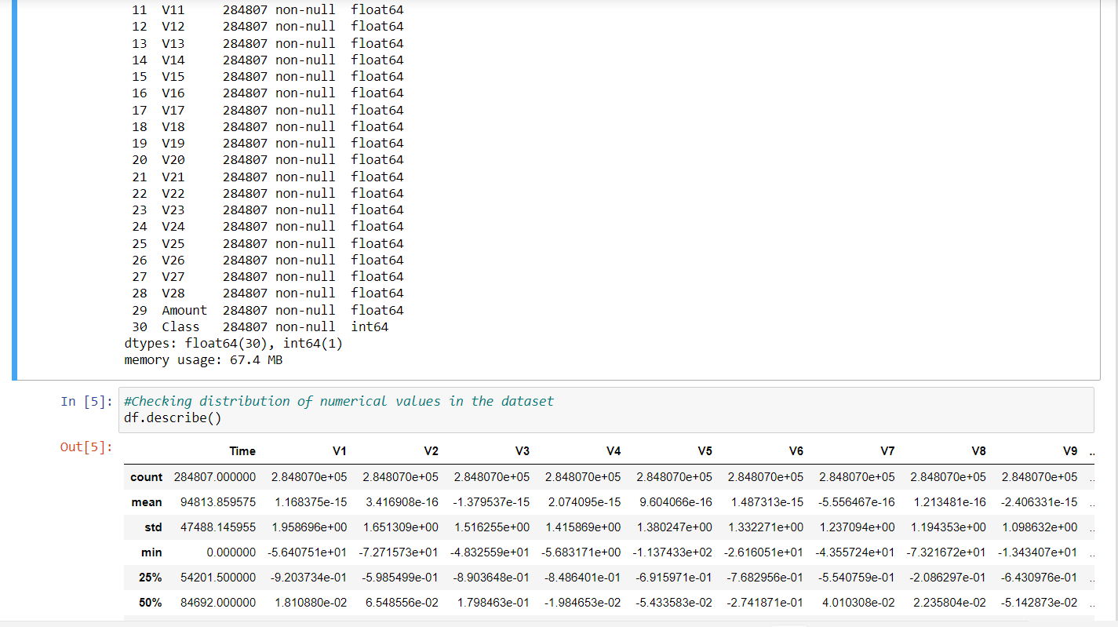

Slide 16
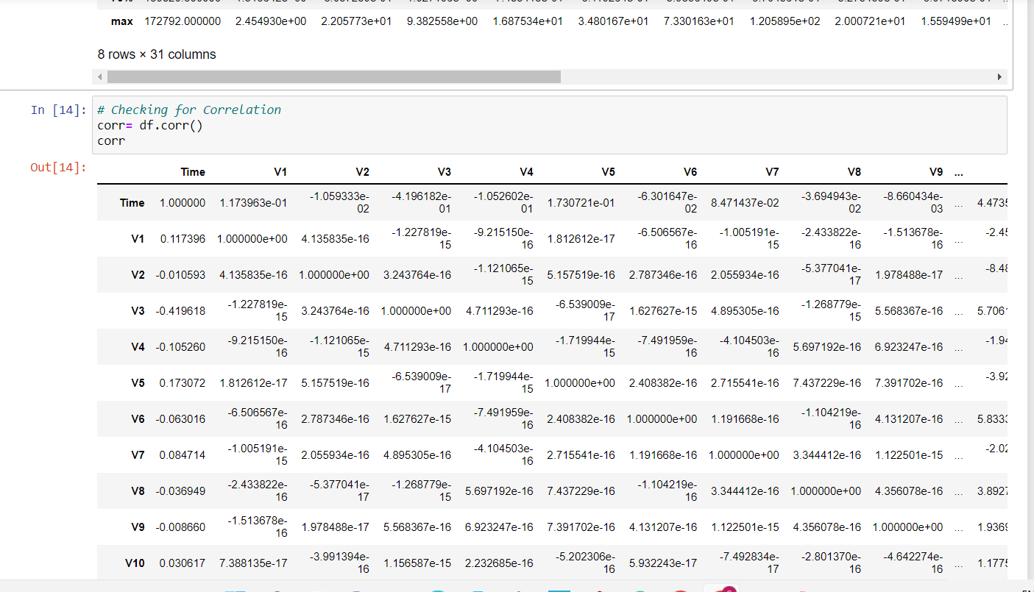

Slide 17
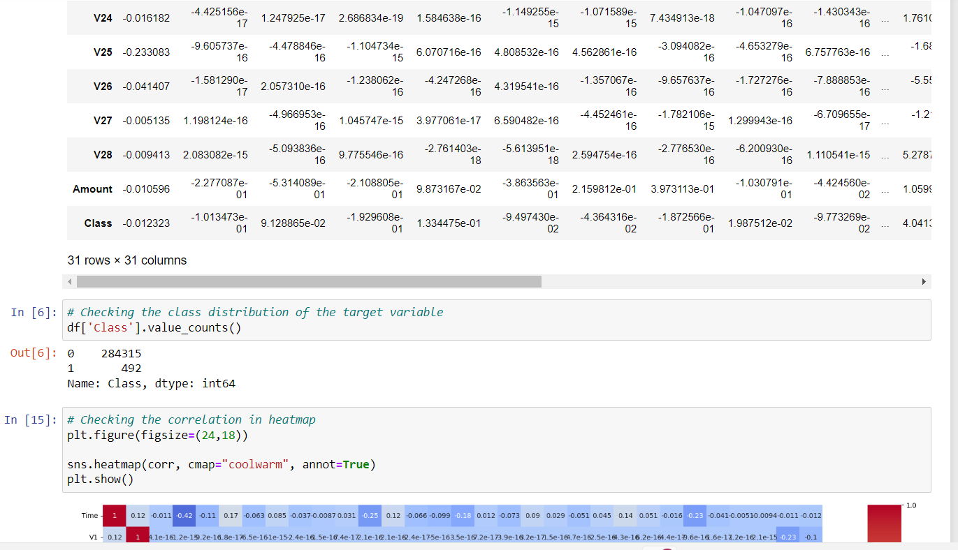

Slide 18
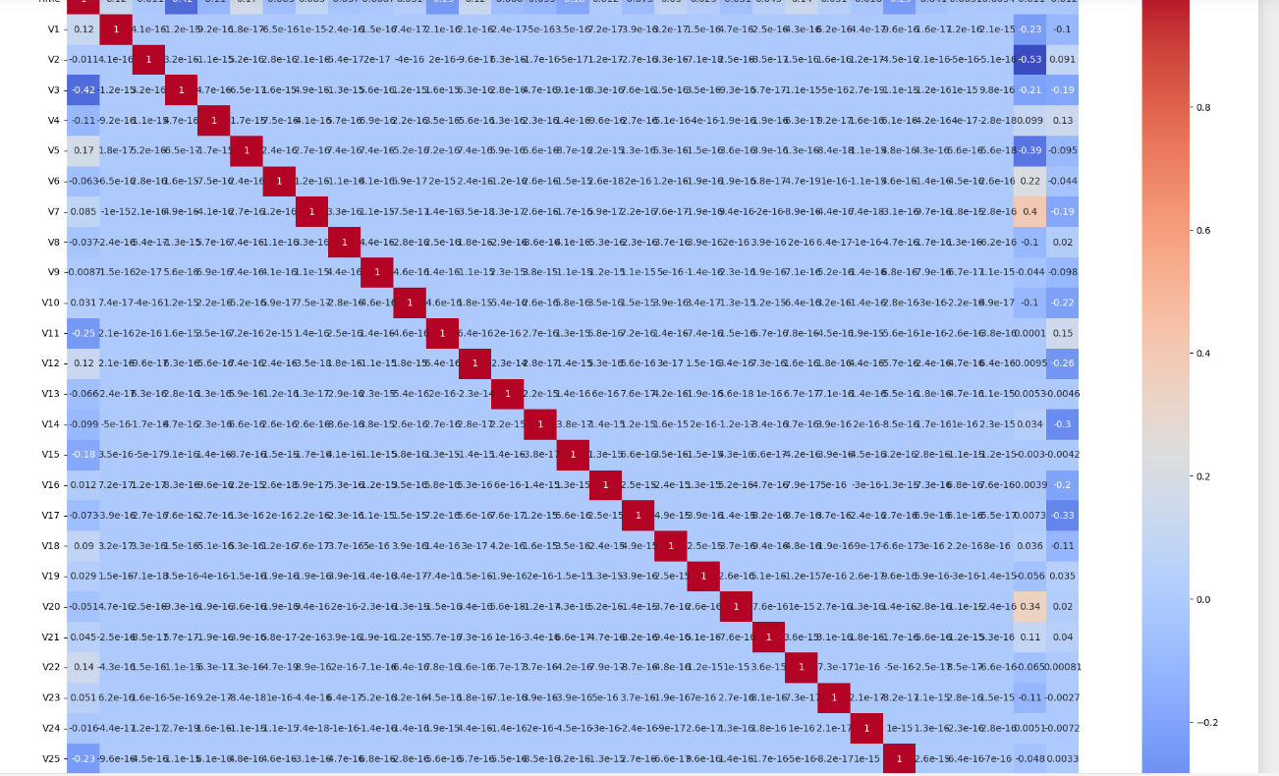

Slide 19
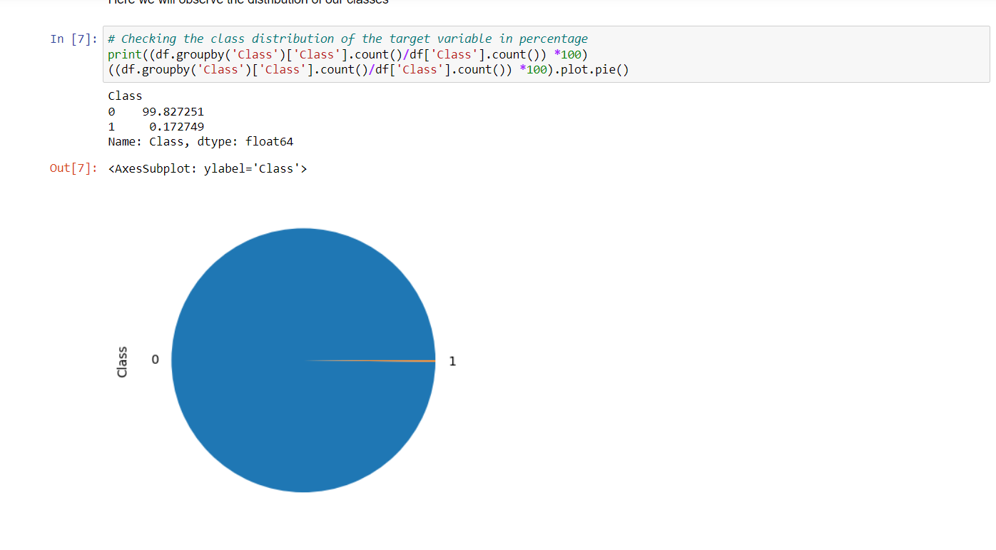

Slide 20
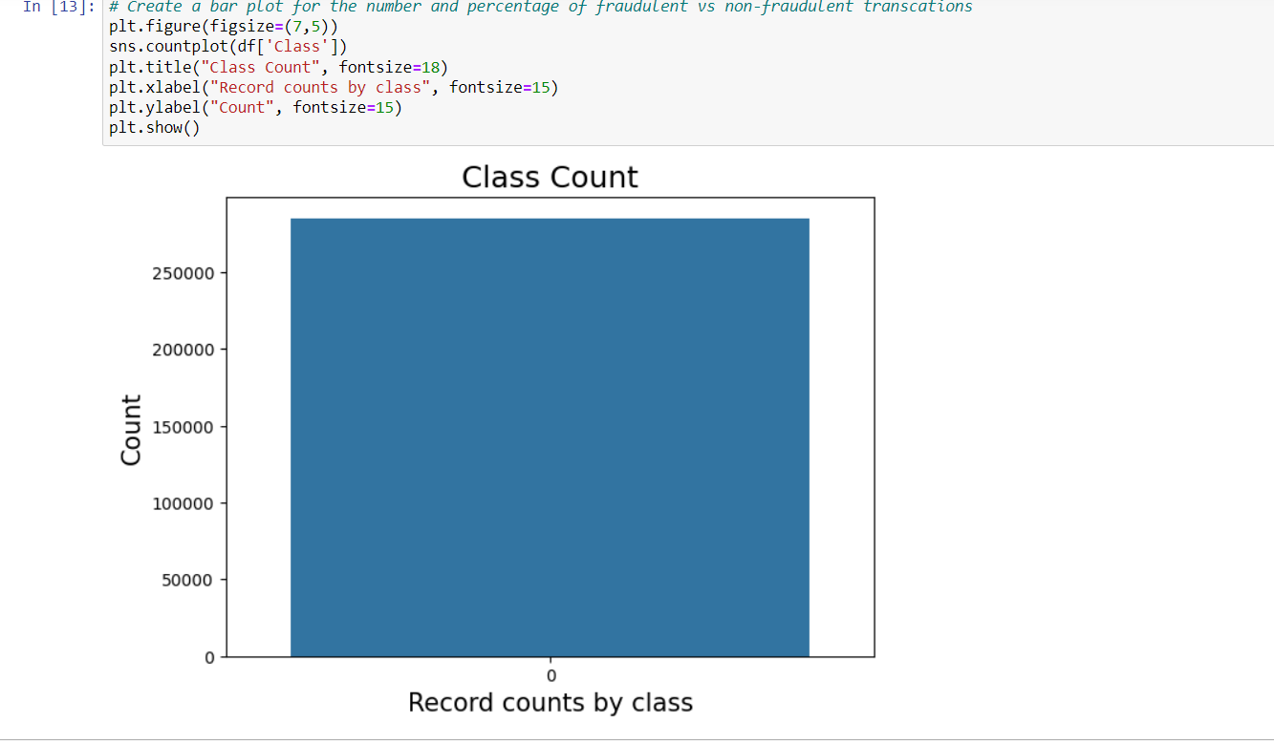

Slide 21
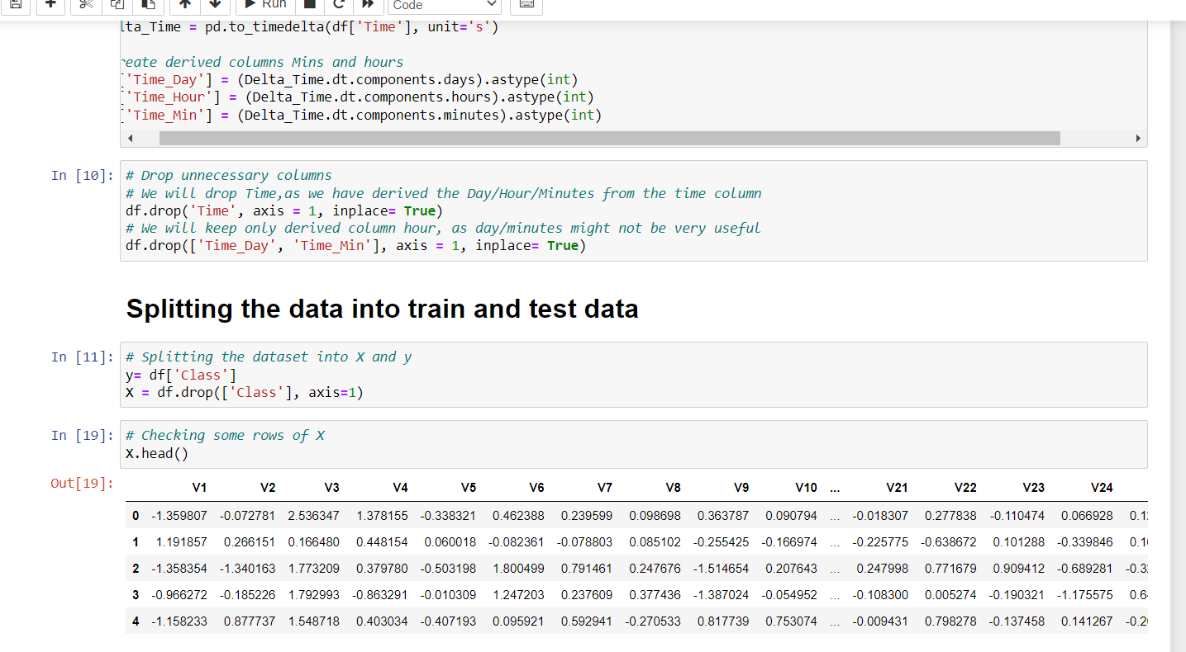

Slide 22
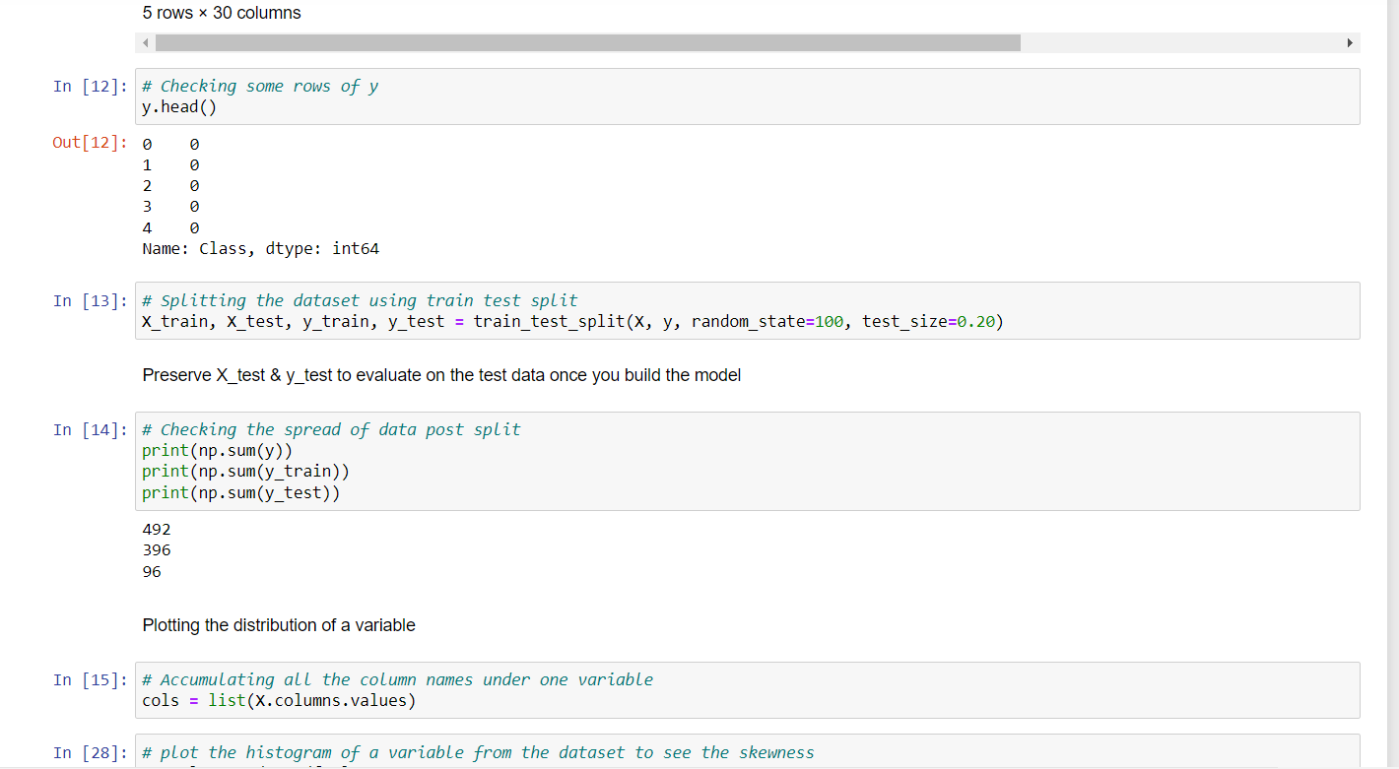

Slide 23
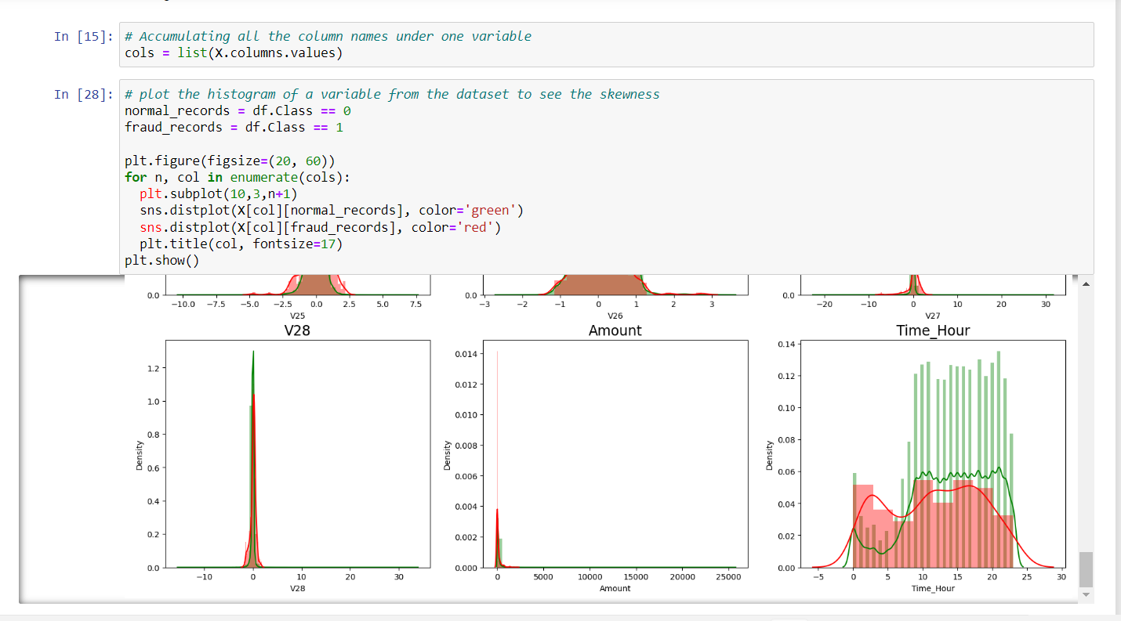

Slide 24
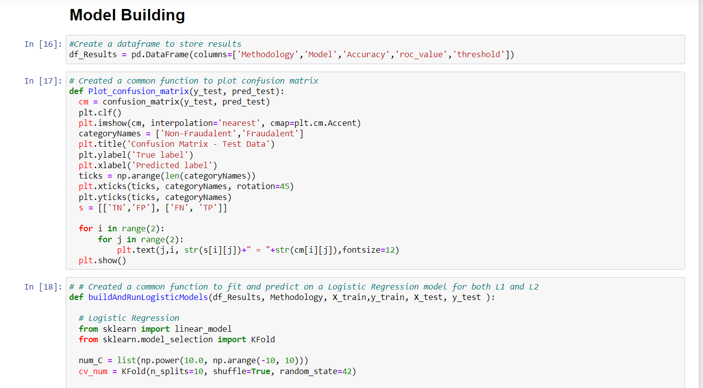

Slide 25
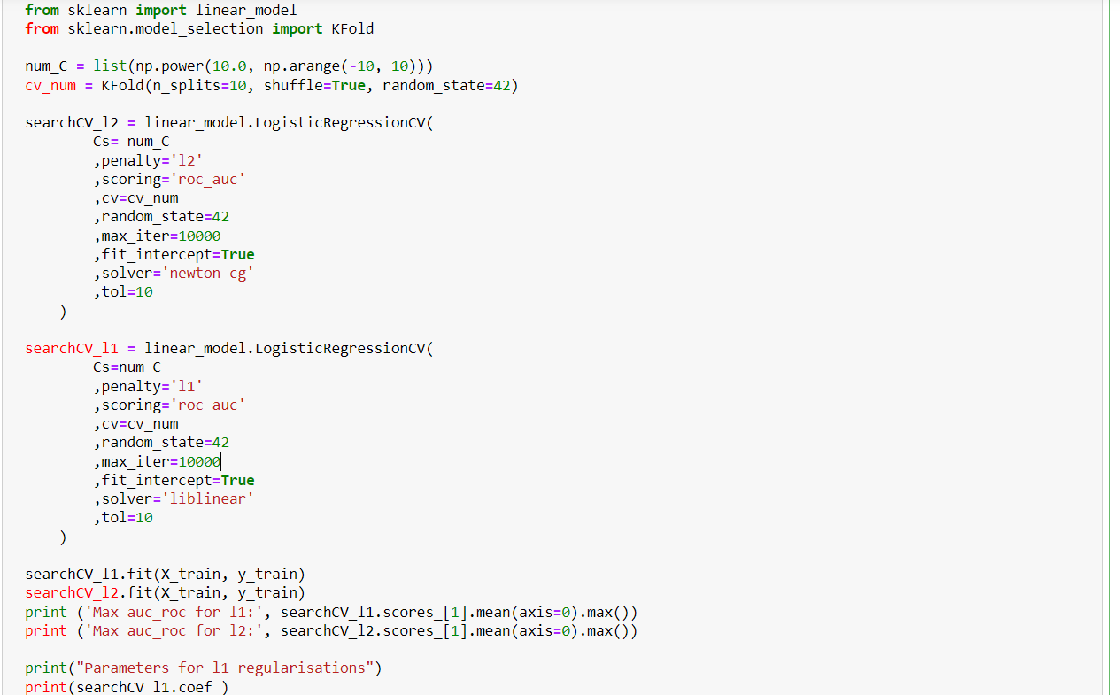

Slide 26
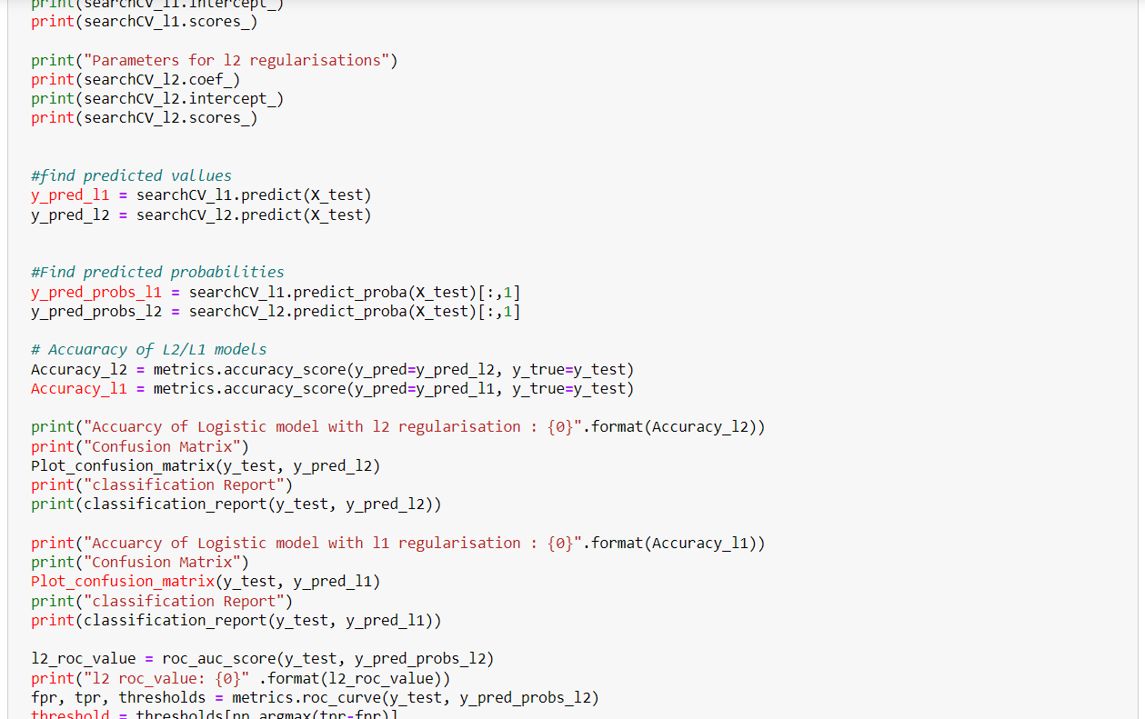

Slide 27
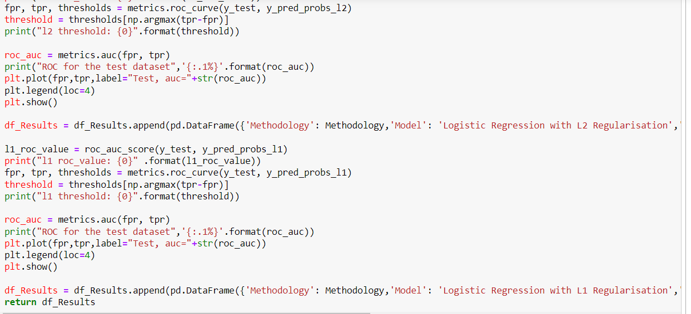

Slide 28
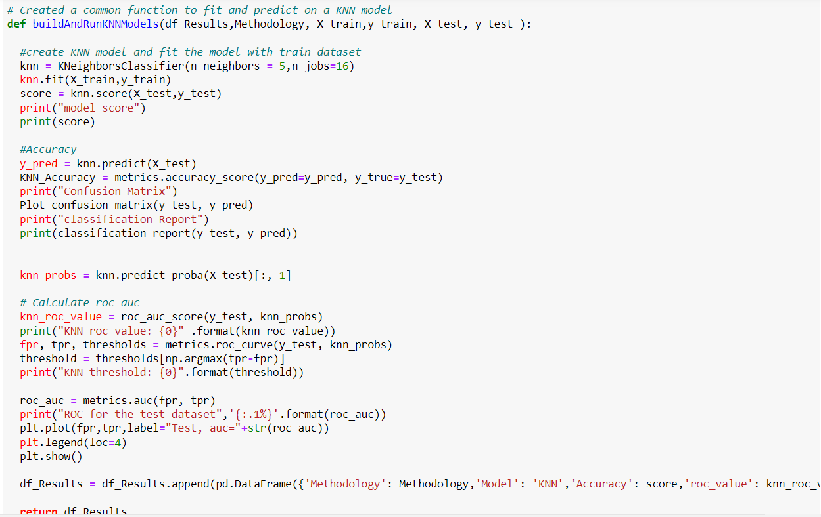

Slide 29
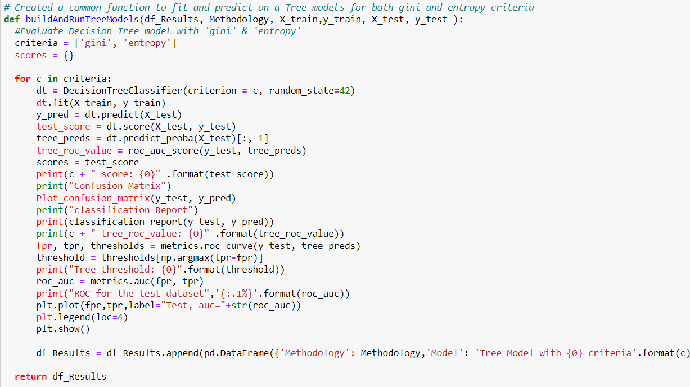

Slide 30
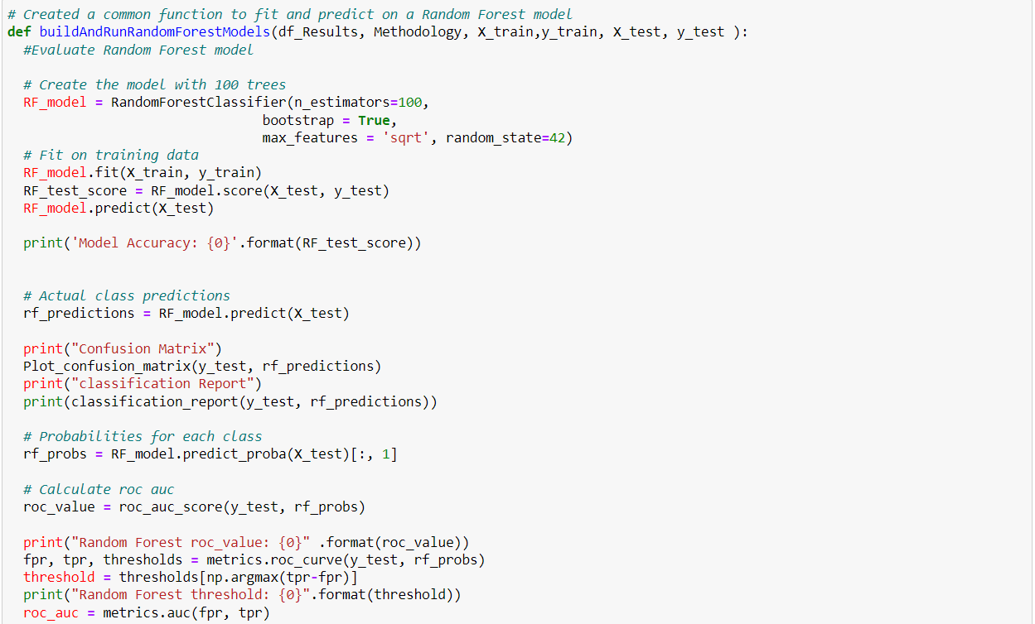

Slide 31
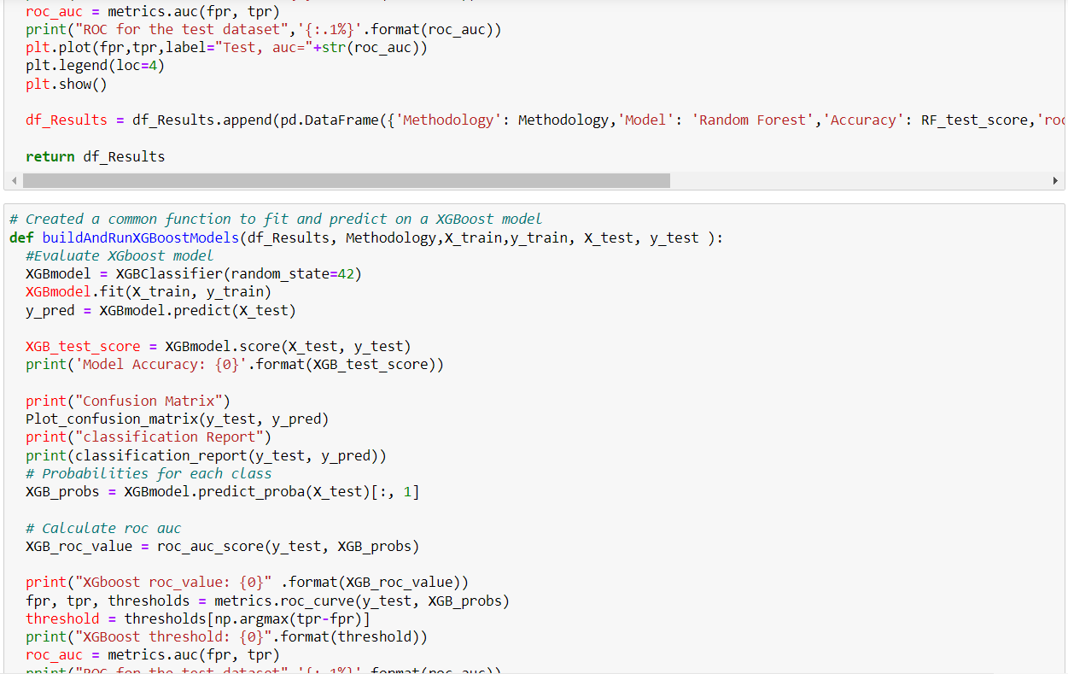

Slide 32
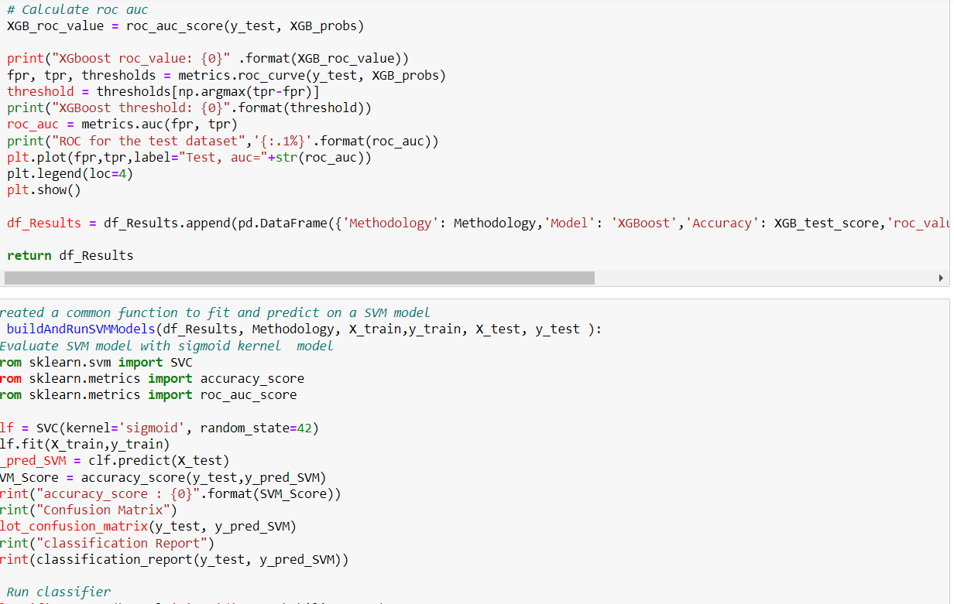

Slide 33
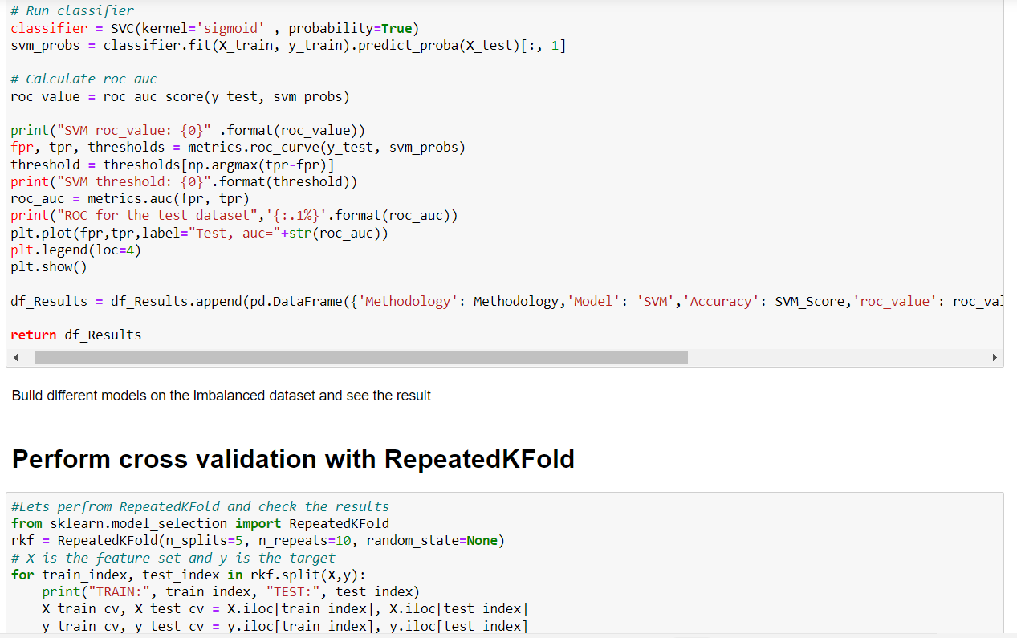

Slide 34
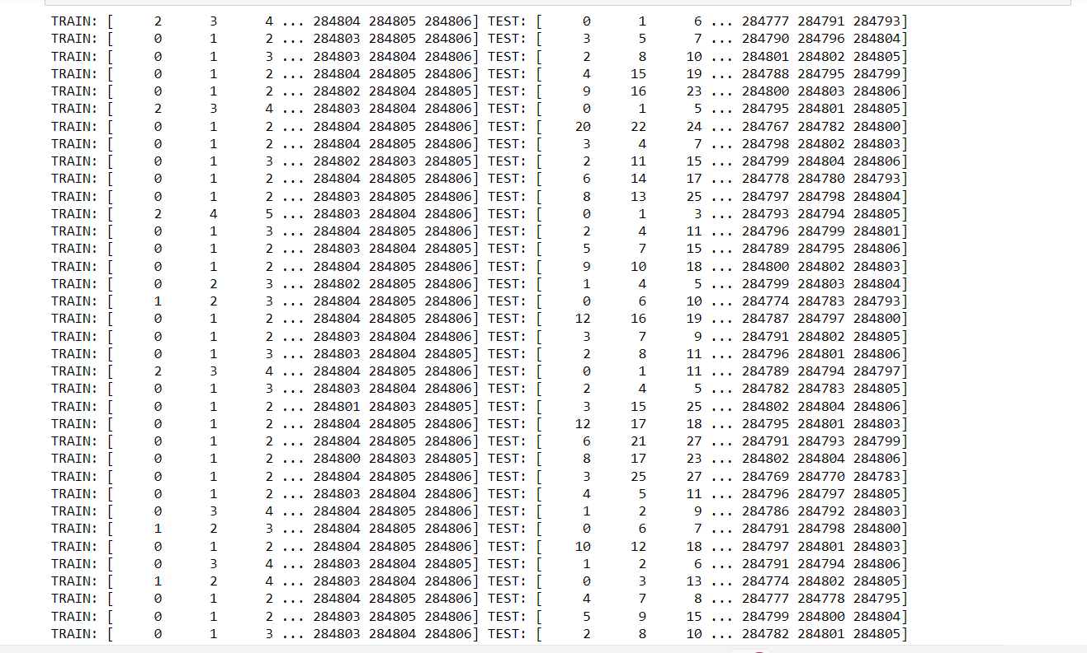

Slide 35
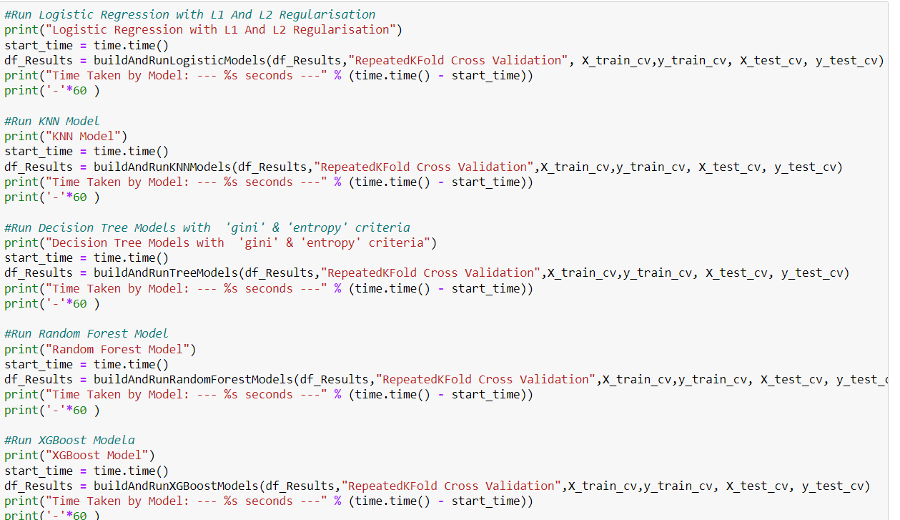

Slide 36
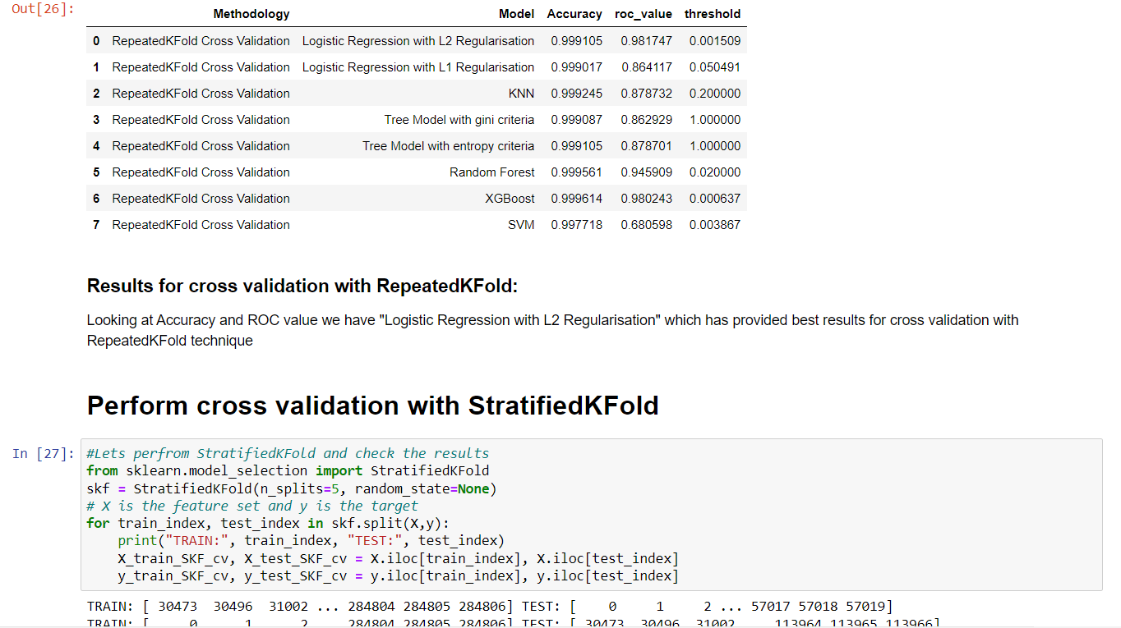

Slide 37
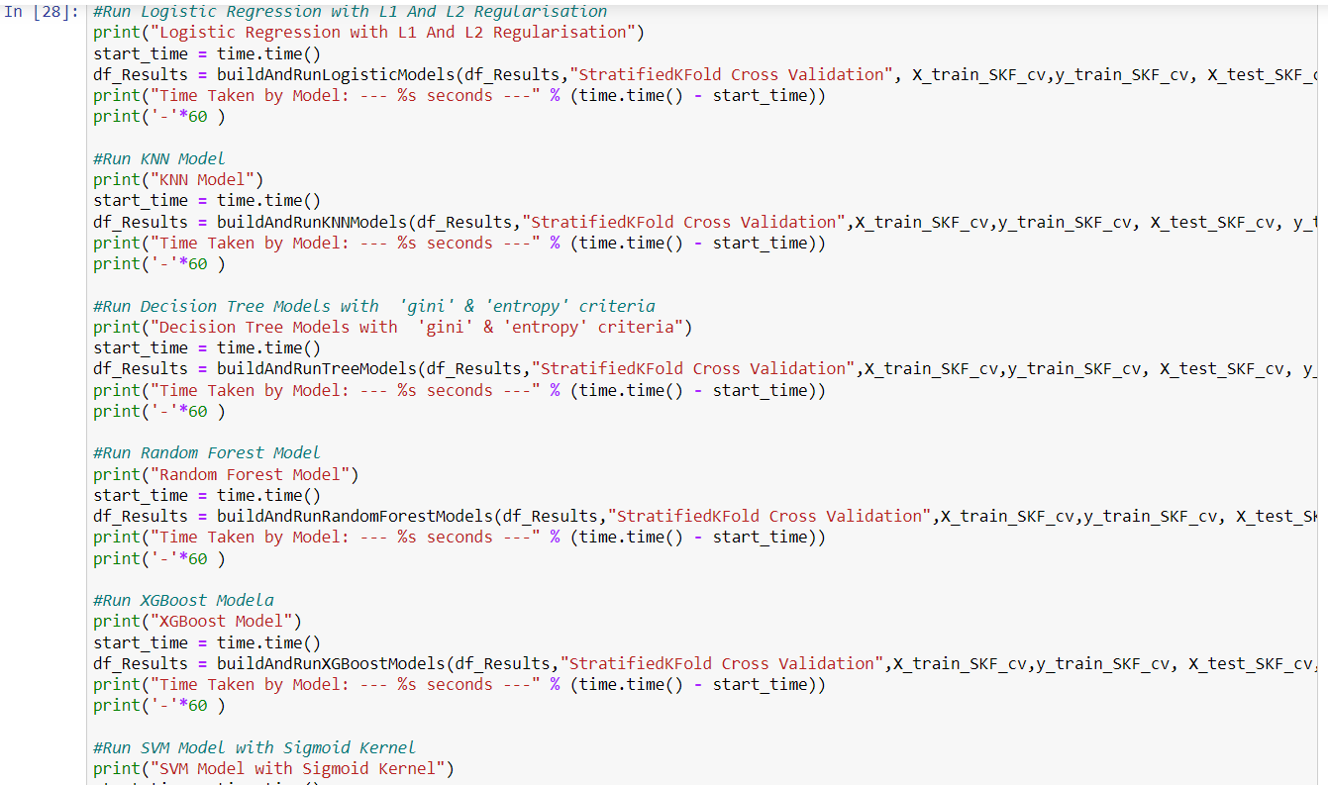

Slide 38
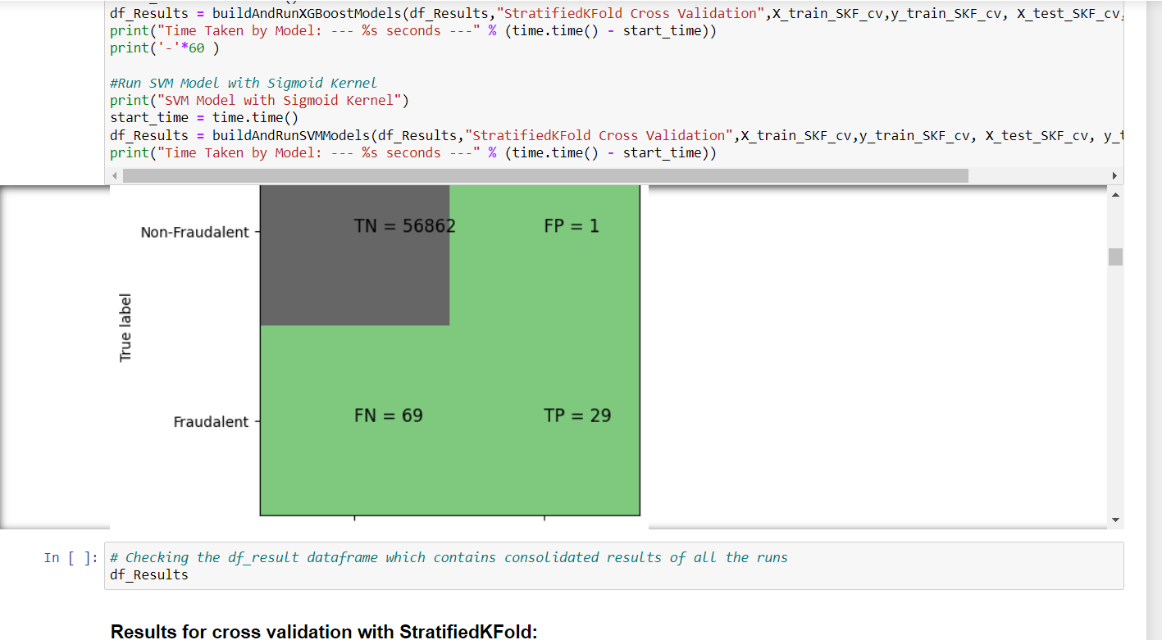

Slide 39
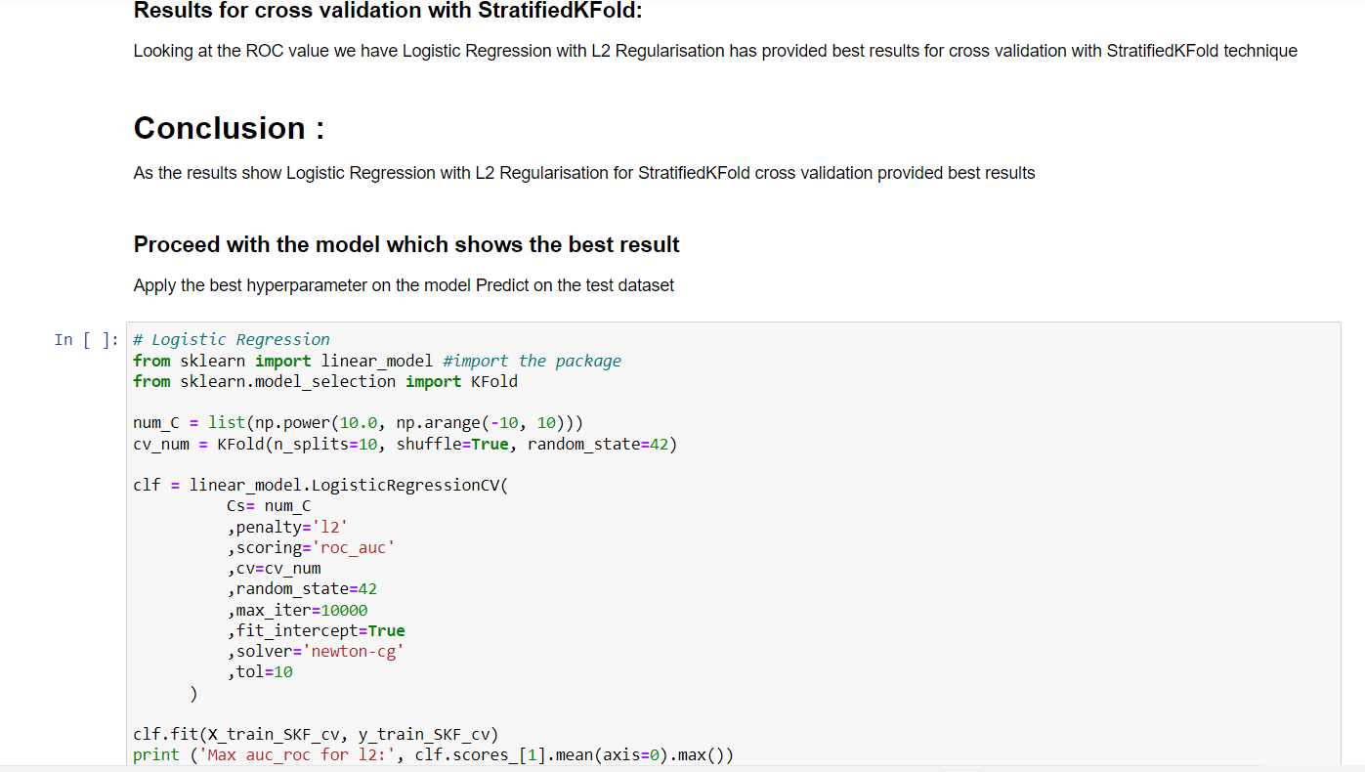

Slide 40
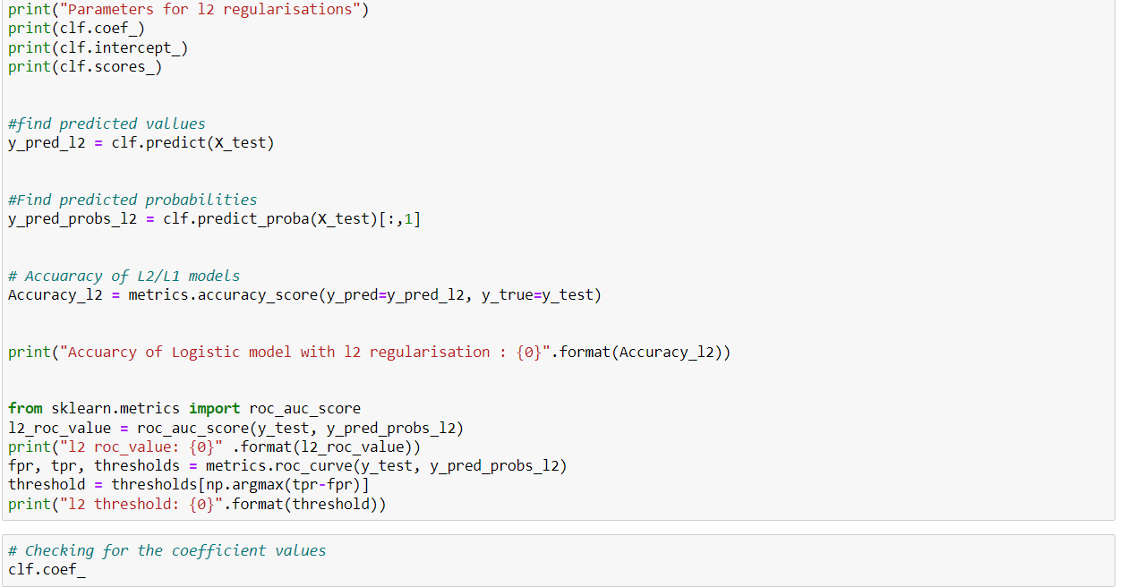

Slide 41
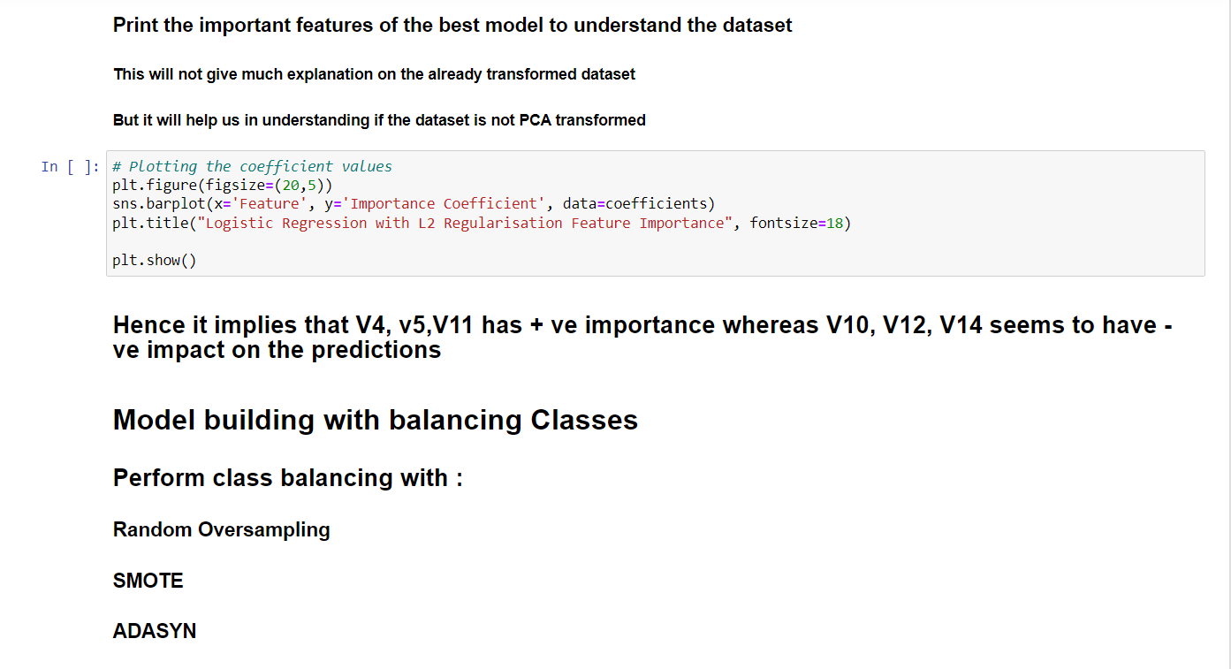

Slide 42
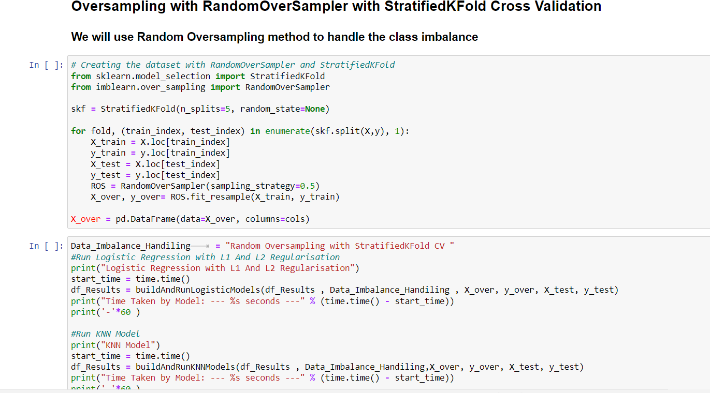

Slide 43
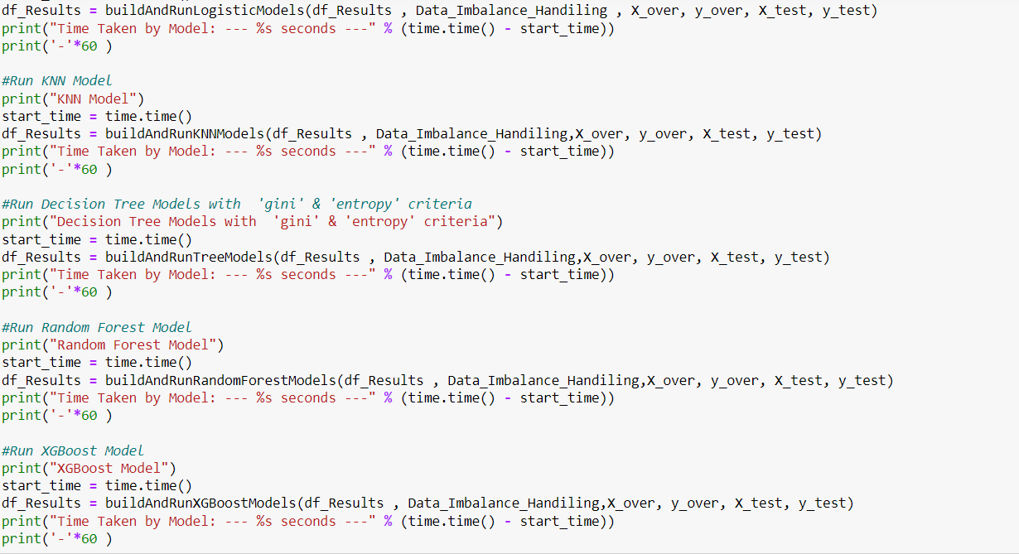

Slide 44
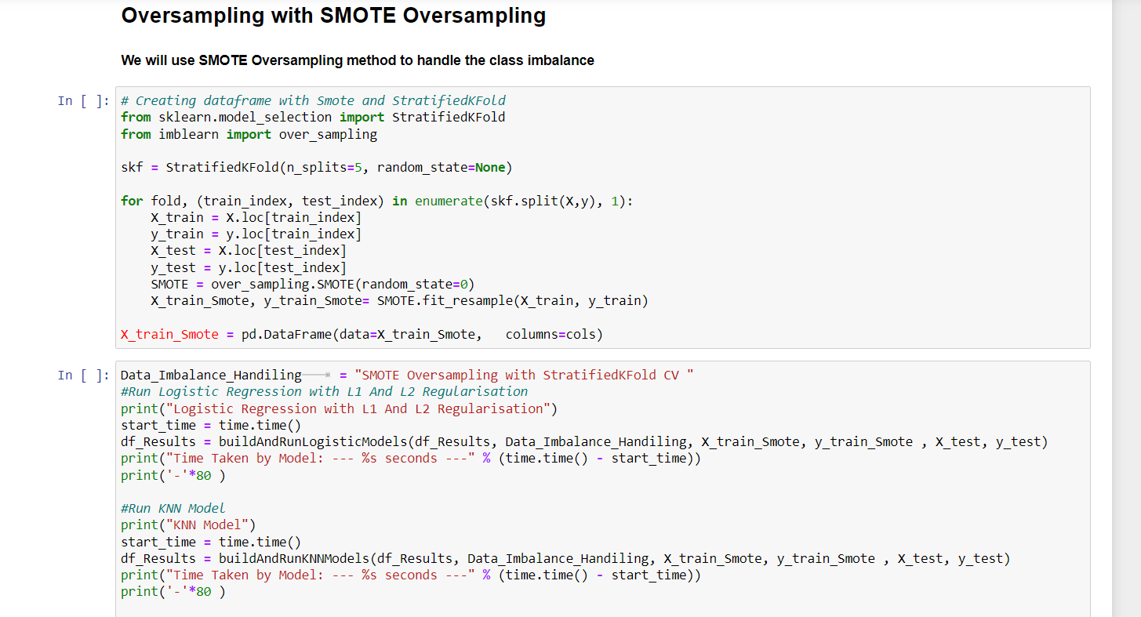

Slide 45
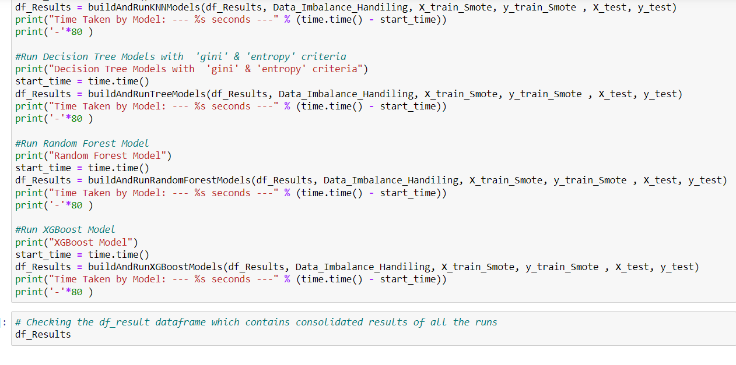

Slide 46
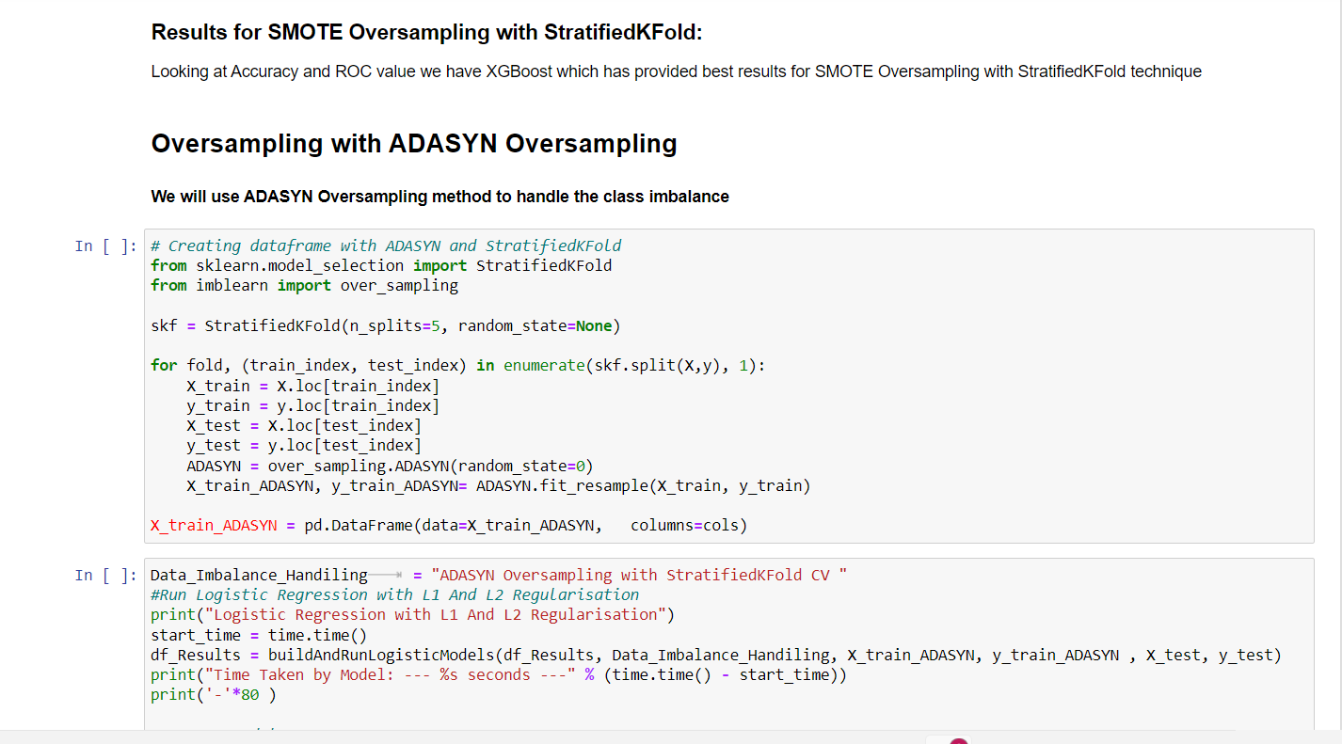

Slide 47
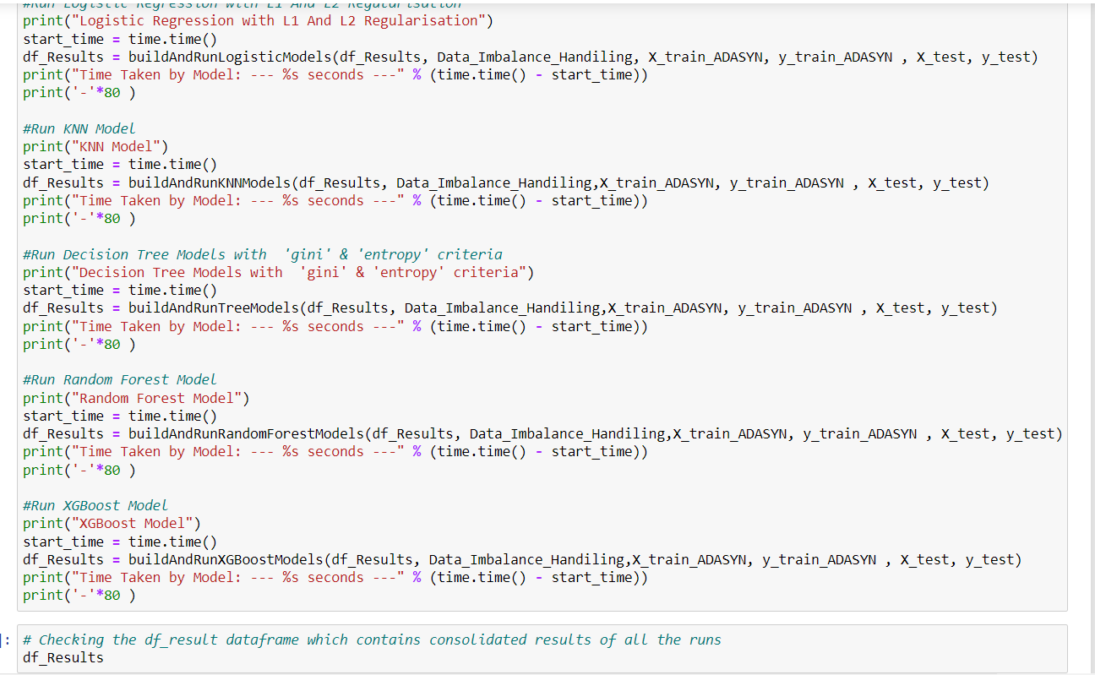

Slide 48
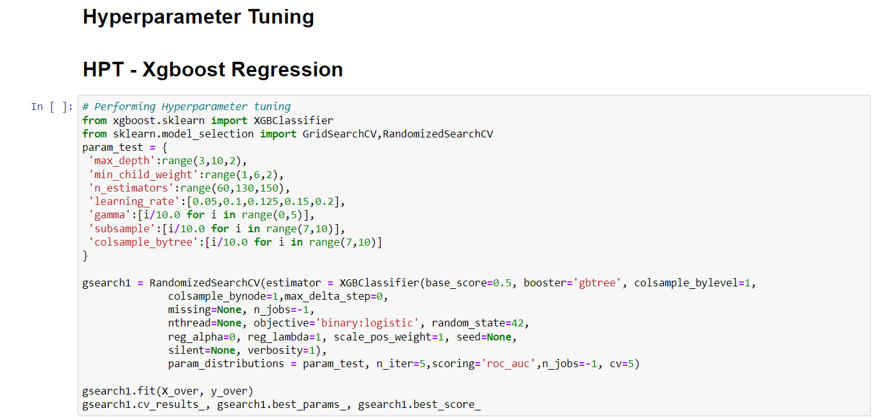

Slide 49
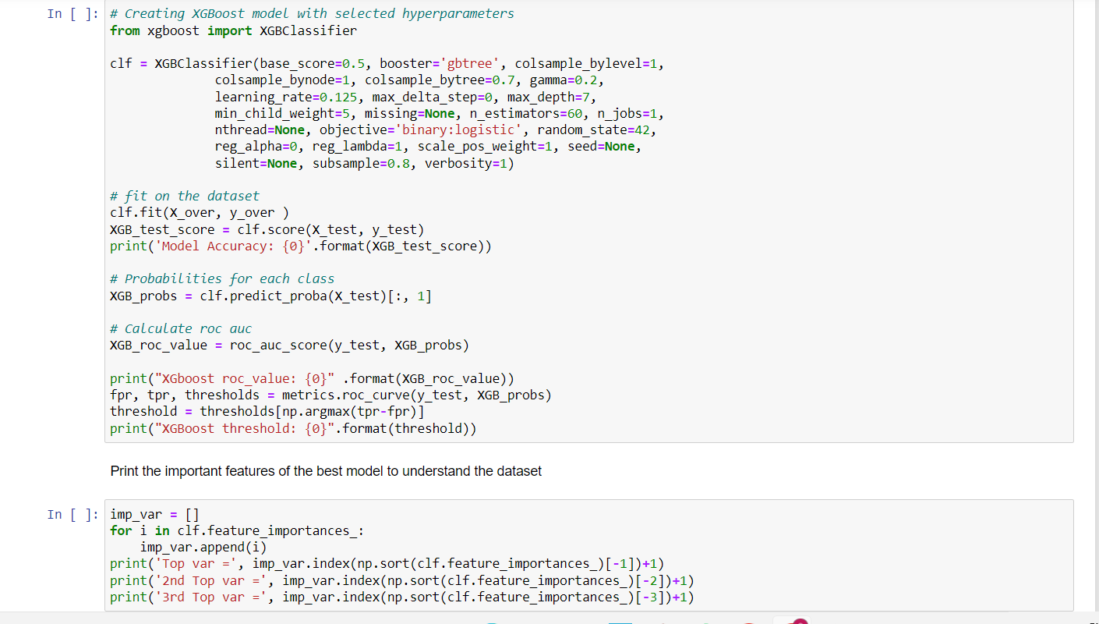

Slide 50
